Slide 1
UNIT 6b:
SOLOMON ISLAND COASTAL FISHERIES

Slide 2
Coastal fisheries
Activity 6.1: Assess prior knowledge by class discussion of their understanding of coastal fisheries in their country

Slide 3
Local Coastal Fisheries
Occur in habitats that includes estuaries, lagoons, sand/mud flats, fringing and barrier reefs, nearshore oceanic waters.
Mostly using traditional canoes but increasingly fibreglass dinghy’s with outboards.
In 2007 estimated total catch from coastal fisheries was 18,250 t (15,000 t subsistence, 3,250 t commercial)
Four major species groups are targeted:
  Demersal fish
  Nearshore pelagic fish
  Invertebrates for export
  Invertebrates for local consumption

Slide 4
Demersal fish
Demersal species – bottom-dwelling fish associated with coral reefs, mangroves and seagrass habitat
Comprise 49 % of the total coastal fisheries catch
Species composition varies greatly throughout SI
See graph next page

Slide 5
Demersal fish

Slide 6
Nearshore & export species
Nearshore pelagic fish
includes tuna, Spanish mackerel, mahi mahi, wahoo and rainbow runner
targeted using trolling or drop lining methods often around nearshore FADs
Invertebrates targeted for export
Mostly sea cucumber and trochus
Sea cucumber fishery banned since 2010 due to overfishing
Trochus harvesting continues but evidence of overfishing

Slide 7
Gleaning
Invertebrates gleaned from intertidal and subtidal areas
diverse range of species with giant clams making up nearly half (by weight)
See graph next slide

Slide 8
Gleaning

Slide 9
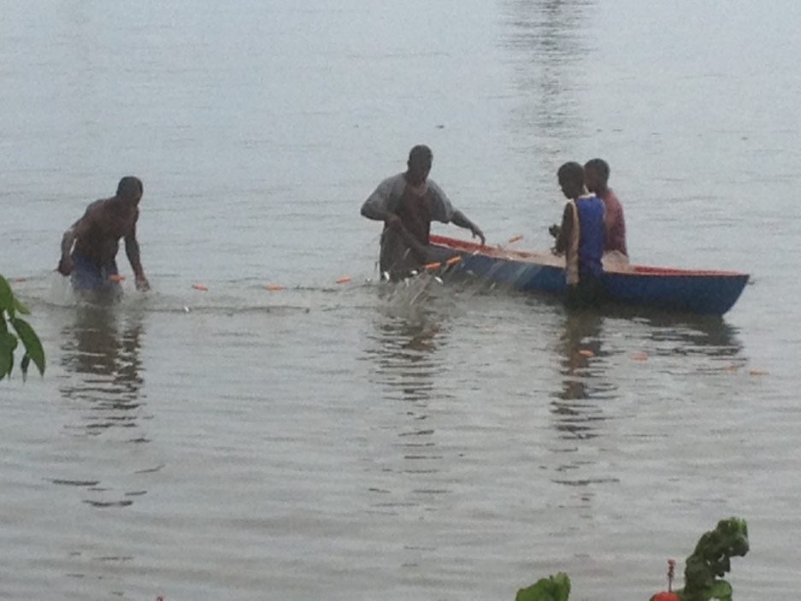
Fishery types
In the Solomon Islands coastal fisheries fall in to two main categories:
Subsistence fishing
Small scale fishing

Slide 10
Subsistence Economy
Subsistence fishing is very important in the Solomon Islands, especially in rural areas where more than 85% of the population live
Provides food for local consumption; family members, community members, or sold locally
Approx. 56 % of rural people (5 % urban) rely on fishing and gardening as their main livelihood
Estimated ½ of all women and 90% of men fish (at least one fisher per household)
Fishing is mostly done in wooden dugout canoes, and motor powered fibreglass boats, using simple fishing gear like handlines, nets or spears. Dynamite is sometimes used despite being illegal

Slide 11
Small Scale Fisheries
Fish are sold at urban centres across the country, principally Honiara
Estimated in 2006 that of all self-employed households 16 % sell fish or other seafood
Rural Fisheries Centre's established in rural areas to assist fishers icing and transporting product to markets
  Has been of limited success but has also proven very helpful where successful (transportation a major issue)
Reef finfish fisheries worth ~ $SBD $ 21.6 million annually
Export of trochus and sea cucumber 2000-2010 worth ~ SBD$45 M
  Sea cucumber fishery banned since 2010

Slide 12
Small Scale Fisheries
Marine ornamental trade
Coral
Live corals have been exported for the aquarium trade since 1995
75 % of all coral exports come from Florida Islands, Central Province
Curio trade
Dead corals exported mainly to the U.S. since 2005
Currently managed by a quota system of select species (in 2010 annual quota was 92,000 pieces)

Slide 13
Target species
Key target species in the Solomon Islands include:
Reef Fishes
Trochus
Lobster/crayfish
Mud Crabs
Coconut Crabs
Farmed Coral/clams
Aquarium Fishes
Curio trade: Dead corals
Shark Fins

Slide 14
Banned Fisheries
Due to over-exploitation:
Beche de mer
Green Snail
Turtles and their eggs
Giant Clams
Crocodile
Black/Gold lip Oysters
Dolphins

Slide 15
Management Regimes
A number of management strategies are applied in the Solomon Islands including:
Moratorium Ban for export
Size Limits
Gear restrictions
Seasonal Closures
Community initiatives – Marine Protected Areas/No take Zones
Alternative Livelihoods

Slide 16
Fisheries status
In 2007 fisheries throughout the Solomon Islands were classified as either fully exploited or collapsed!
Particular species groups determined to be overfished include:
parrotfish
sea cucumber
giant clams
green snails
sharks

Slide 17
Activity 6.2 – Select one of the local fisheries identified above or another fishery you know about, and describe its key characteristics.
This should include aspects such as: species targeted, their life history & biology, where are they caught, who catches them, what methods/gears are used, catch volumes and trends, management, how many vessels, how much is exported, etc.

Slide 18
Reflection
Reflection: unit review, students to review main concepts of unit in the course notes, contribute any new words (new to them) to their own personal glossary in the back of their notebook (local language equivalent terms should also be recorded where possible)

